Slide 1
Credit card approval presentation

Slide 2
Agenda
Problem Statement
Dataset
Data Preparation
Models Used
Model Evaluation Metrics
Results (with table or printout)
Confusion Matrix
ROC Curve
Feature Importance
Challenges & Next Steps
Conclusion

Slide 3
Why it matters
Credit card approvals impact millions of people.
Automating decisions can speed up processing and reduce bias.
Getting approved for a credit card can be a long process. Automating this with accurate models helps both banks and customers by making quick and fair decisions.

Slide 4

Dataset
Source: CSV file with customer data.
Features: Age, Income, Employment Status, Credit Score, etc.
Target: Approved (Yes/No)
The dataset contains customer demographics and financial info. Our goal is to predict if an applicant will be approved or not.

Slide 5
Data preparation
Split data into training and testing sets.
Standardize numerical features.
One-hot encode categorical features.
To prepare the data, I split it into train and test sets. Then I scaled numerical values and converted categories into numerical format for the models.

Slide 6
Models Used
Logistic Regression
Random Forest
I tested two popular models — Logistic Regression, which is simple and interpretable, and Random Forest, which often performs well with tabular data.

Slide 7
Model Evaluation Metrics
Metrics:
Accuracy
Precision
Recall
F1 Score
ROC AUC
To evaluate the models, I used multiple metrics to understand overall accuracy and how well the models identify approved vs. rejected applicants.

Slide 8
Results
Model | Accuracy | Precision | Recall | F1 Score | ROC AUC
Logistic Regression | 0.75 | 0.80 | 0.85 | 0.82 | 0.83
Random Forest | 0.78 | 0.82 | 0.88 | 0.85 | 0.88
The Random Forest outperformed Logistic Regression on all metrics, showing it’s a better choice for this problem.

Slide 9
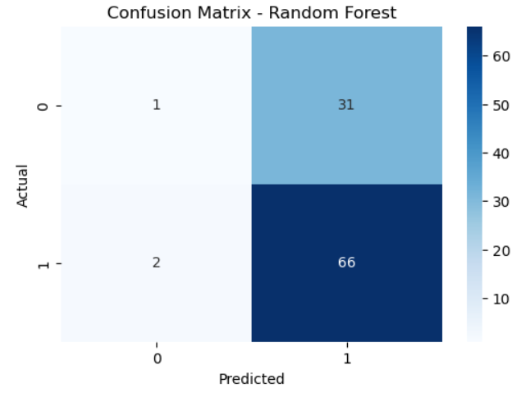
Confusion Matrix
This confusion matrix shows how often the model predicts approvals correctly, as well as the types of errors it makes

Slide 10
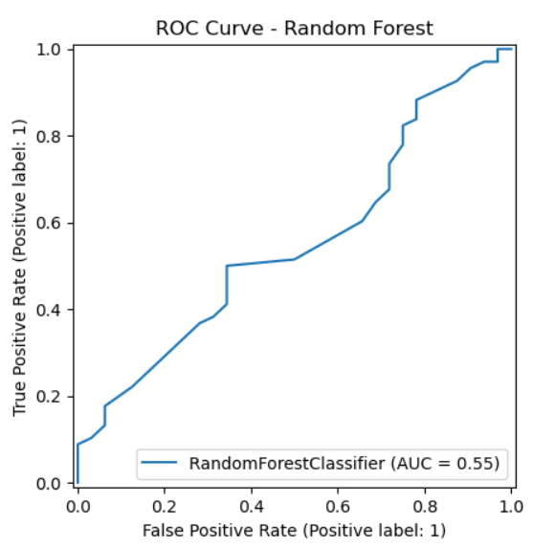
ROC Curve
The ROC curve illustrates the trade-off between true positive and false positive rates. The closer the curve to the top-left, the better the model

Slide 11
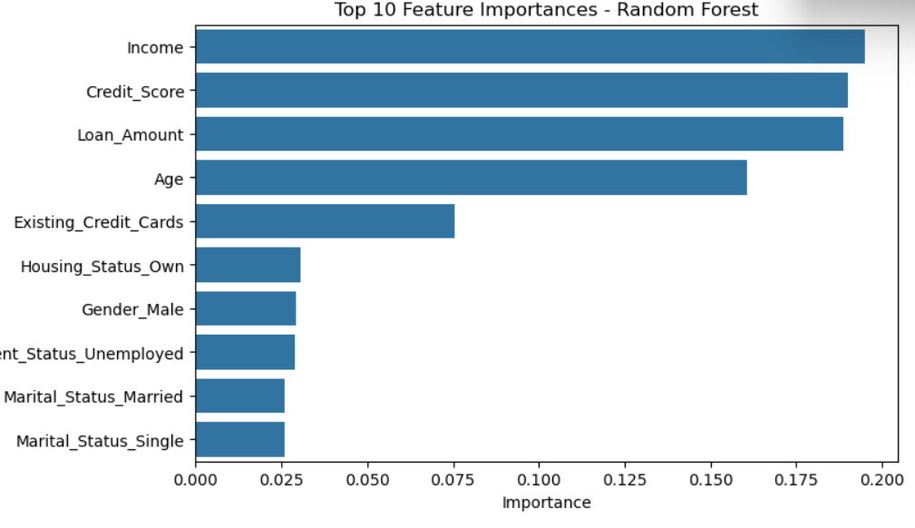
Feature Importance
The most important features influencing decisions were [list top features]. This insight helps understand what drives approvals.

Slide 12
Challenges & Next Steps
Dataset limitations
Need for hyperparameter tuning
Potential for model deployment
Using interpretability methods like SHAP
Some challenges were dataset size and complexity. Future work includes trying more models, tuning parameters, and deploying the model for real-world use.

Slide 13
conclusion
To conclude, machine learning can effectively predict credit card approval, potentially improving decision speed and fairness. Thank you for tuning in
Contact me:
tshikovhitshedza9@gmail.com
0760293340

